Slide 1

SuperBIT Calibration
Liam O’Shaughnessy
07/30/2024

Slide 2
Objective - Photometric Calibration with Hyper-Suprime Cam
Determine a good multiplicative factor [HSC’s/counts] that relates SuperBIT flux values to HSC flux values, per band combination
Flux_HSC_band_j = alpha_ij * Flux_BIT_band_i

Slide 3
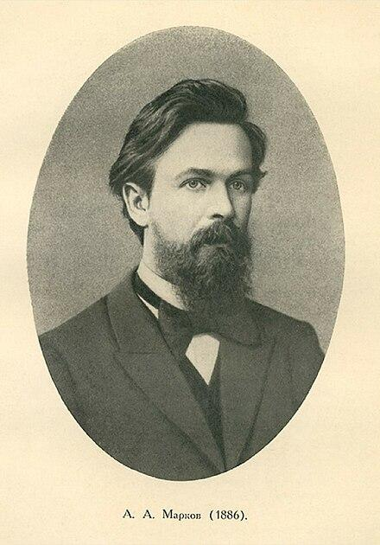

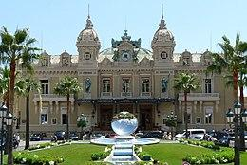
Markov Chain Monte Carlo
Markov
David W. Hogg
Casino de Monte Carlo

Slide 4
Method
Subject to BIT_flux > 0.005 (eliminates very dim objects), PSF-like curve elimination, S/N (flux/background) >10, BIT_flux <0.07 (dim region of a1689 in same brightness regime as cosmosk), and visually-inspected outlier exclusion from large residuals

Slide 5
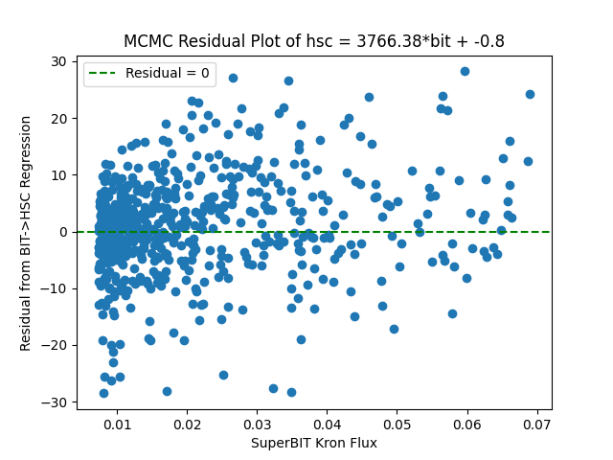
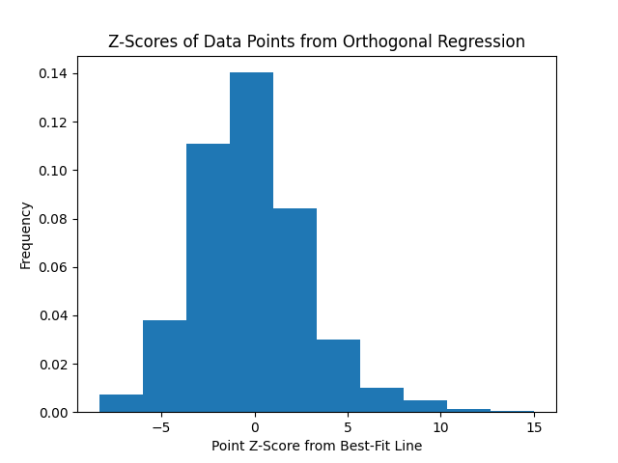
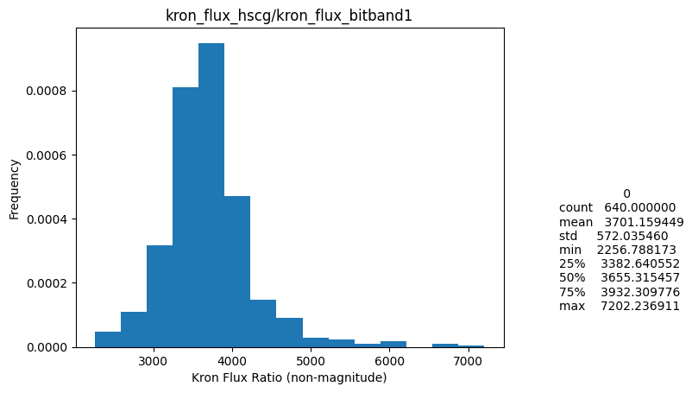
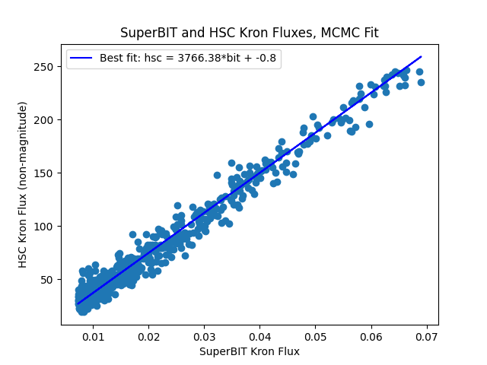
BIT 1 x HSC g - a1689
%data remaining after outlier exclusion: 95.8%

Slide 6
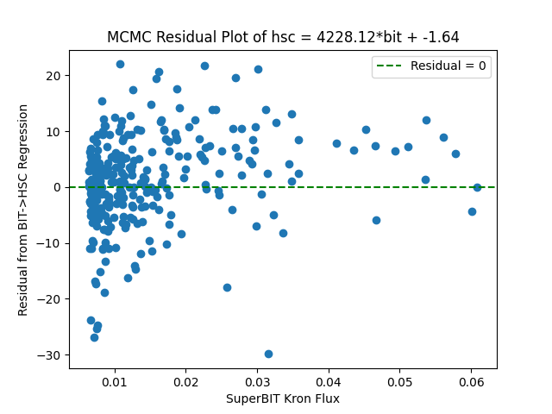
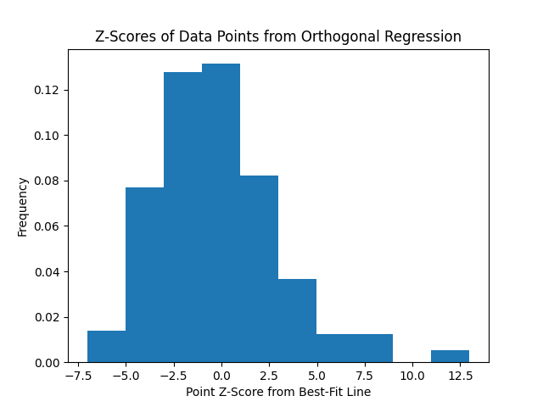
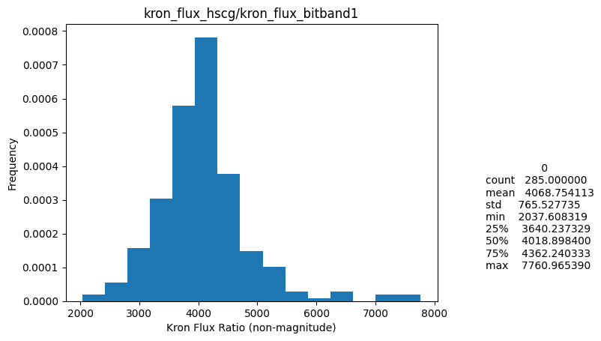
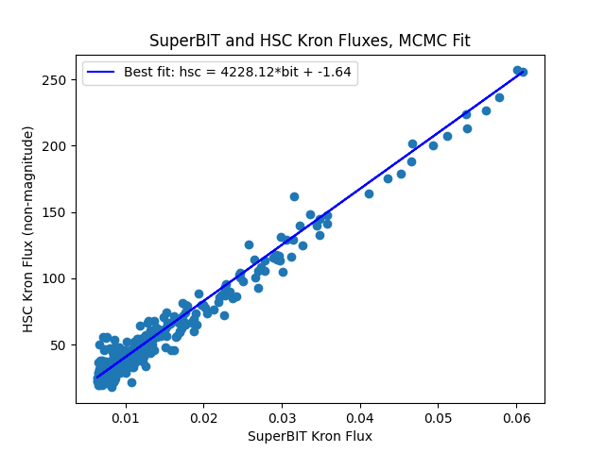
BIT 1 x HSC g - cosmosk
%data remaining after outlier exclusion: 91.9%

Slide 7
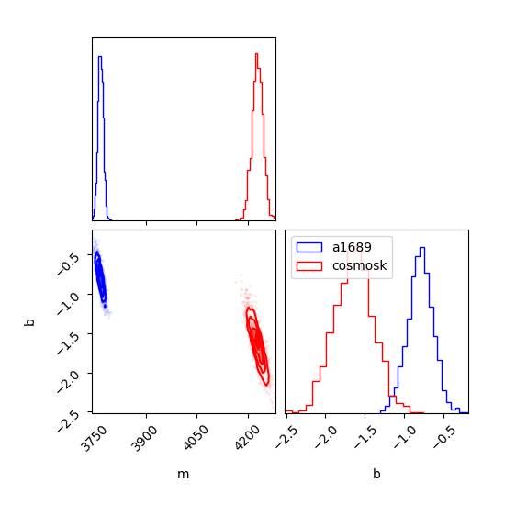
BIT 1 x HSC g
MCMC

Slide 8
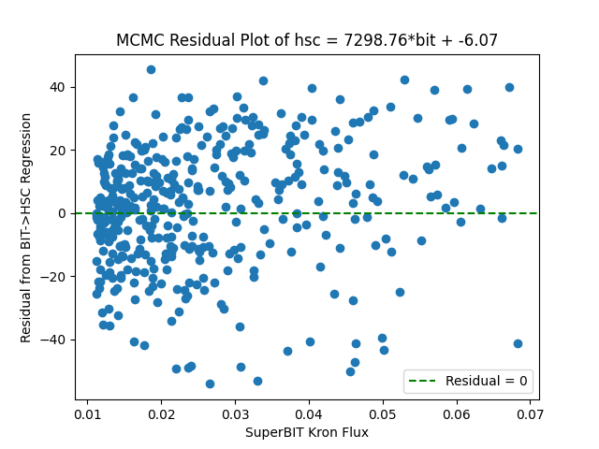
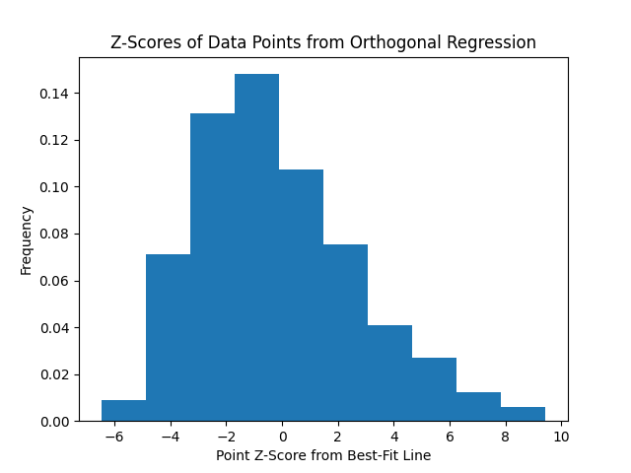
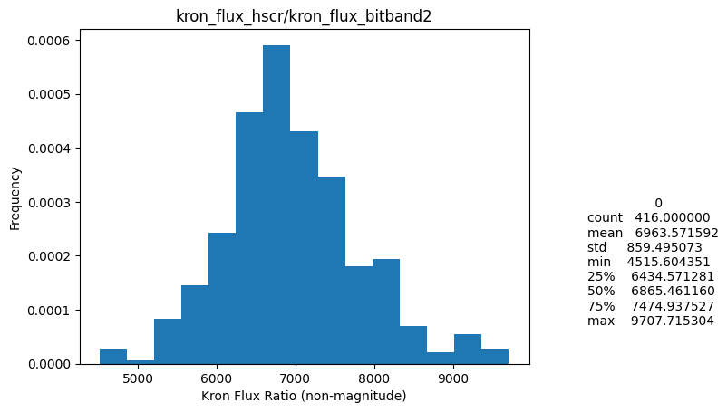
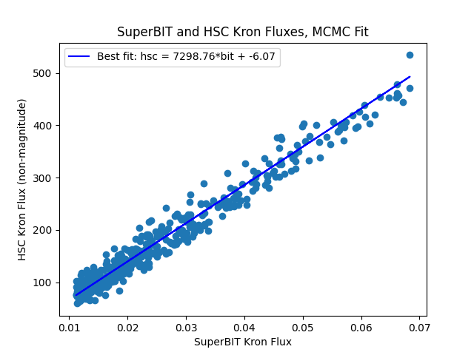
BIT 2 x HSC r - a1689
%data remaining after outlier exclusion: 90.8%

Slide 9
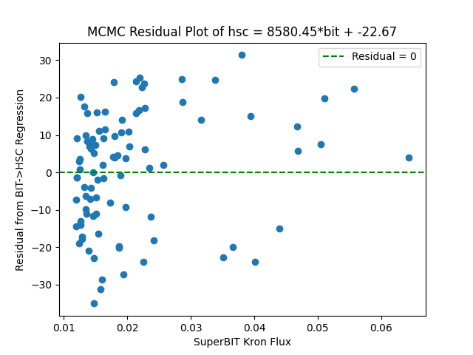
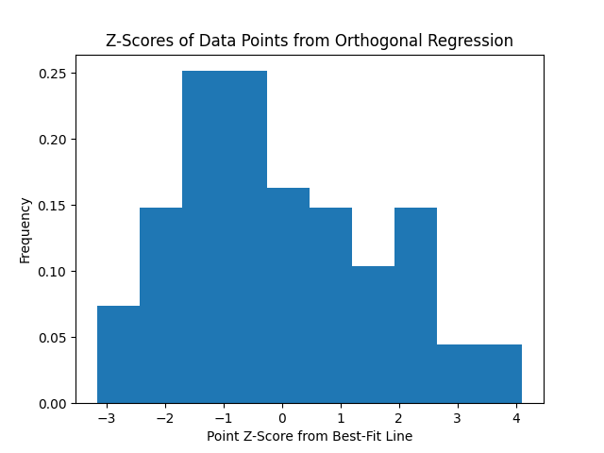
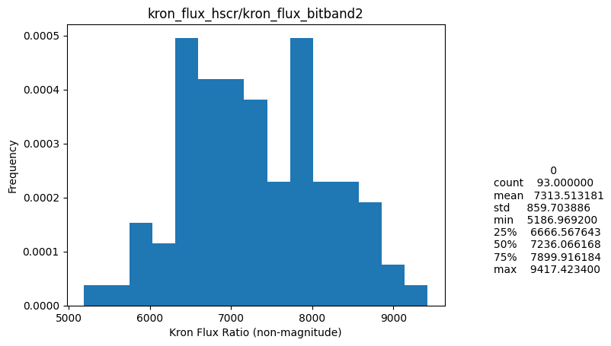
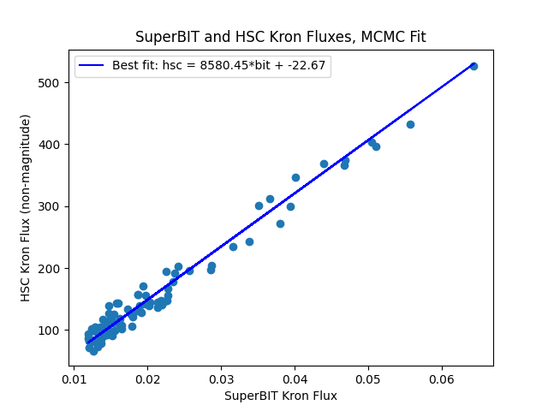
BIT 2 x HSC r - cosmosk
%data remaining after outlier exclusion: 54.1%

Slide 10
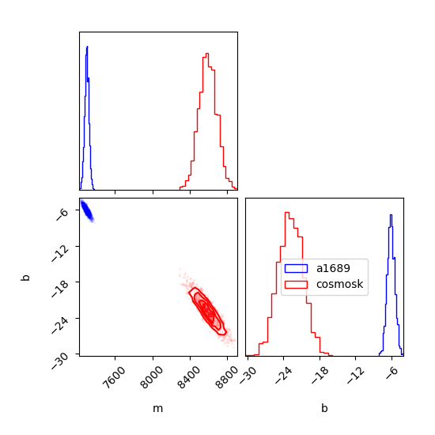
BIT 2 x HSC r
MCMC

Slide 11
Object Densities of Fields

Slide 12
Motivation and method
Many good, bright points in SuperBIT’s cosmosk data excluded due to their HSC counterpart object being blended; can we quantify why?
Hypothesis: greater blending associated with worse angular resolution and greater density of objects in the vicinity of the object of interest
For every raw field of vision (i.e. unmatched set of points), restrict to the common window of observation, then, about every object, count the number of objects in a 0.005 degree radius -> “neighbor density”
Replacing counting the total number of objects with only objects whose flux is above the mean flux -> “bright neighbor density”

Slide 13
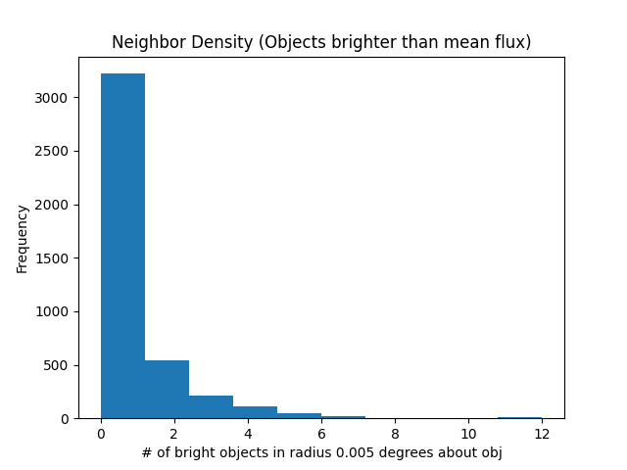

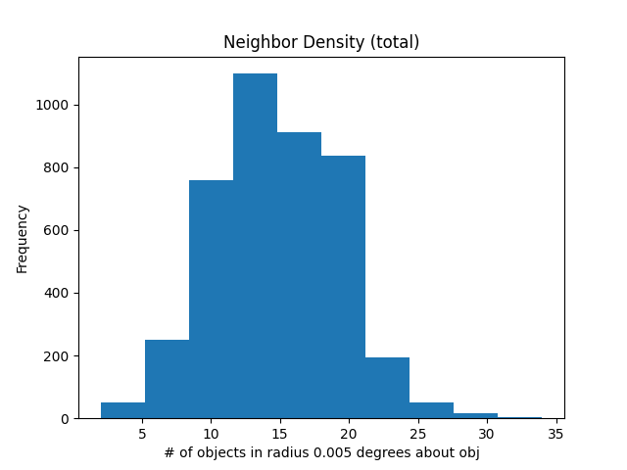
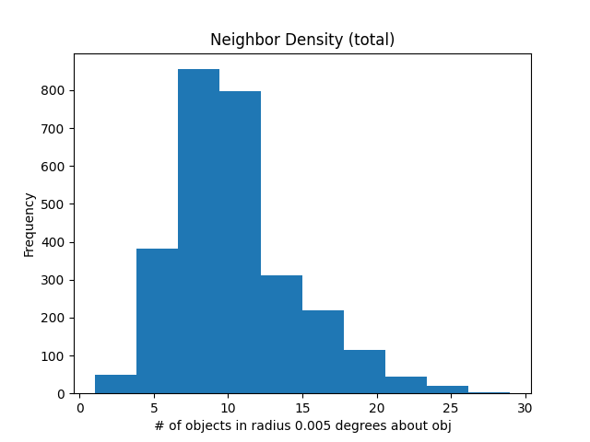
A1689, over common window
BIT 1
BIT 2

Slide 14
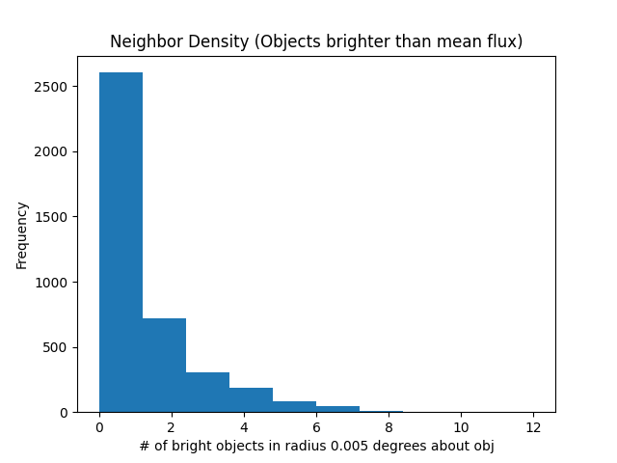
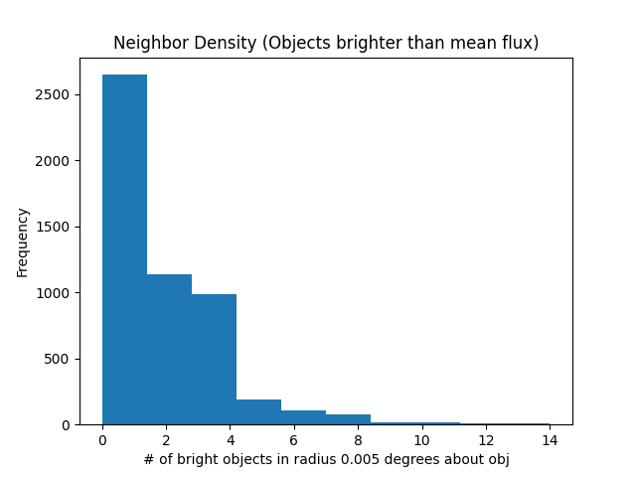
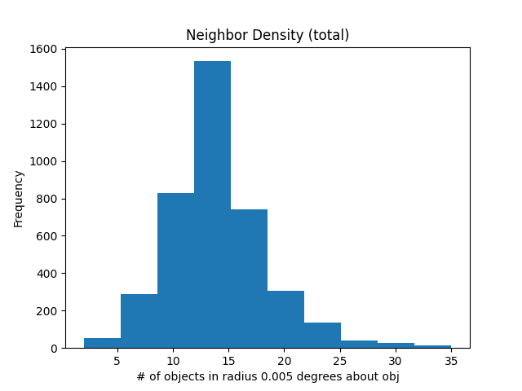
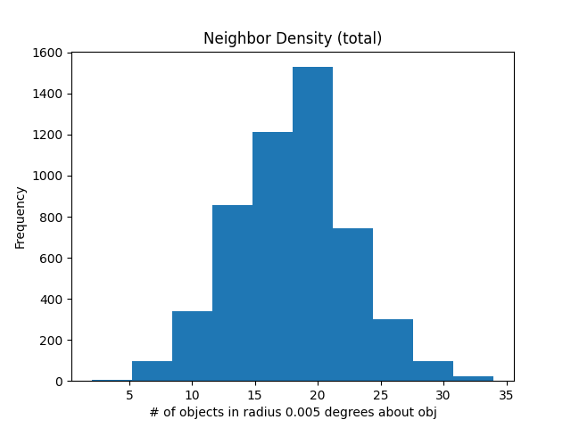
A1689, over common window
HSC g
HSC r

Slide 15
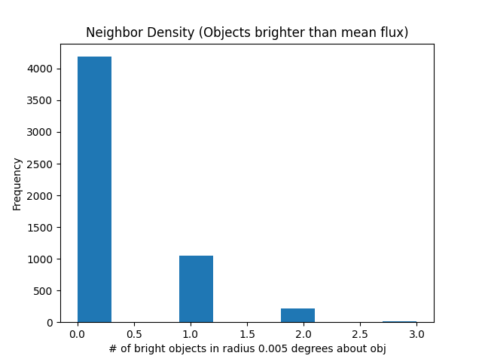
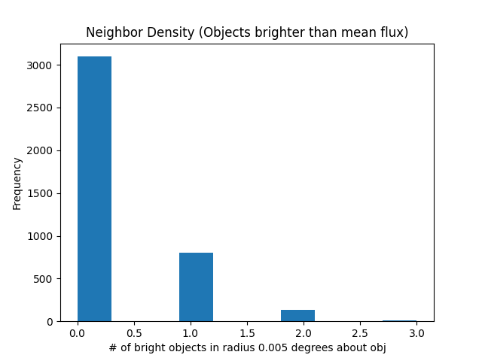
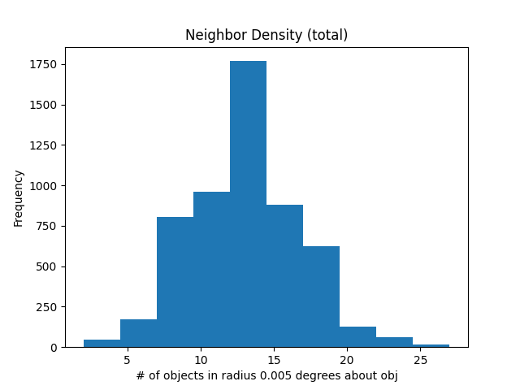
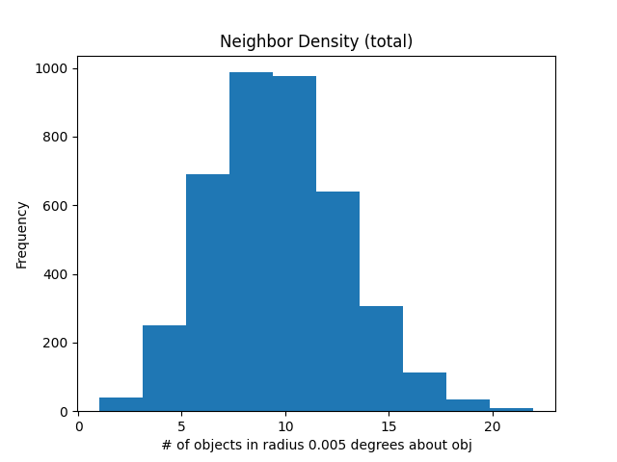
Cosmosk, over common window
BIT 1
BIT 2

Slide 16
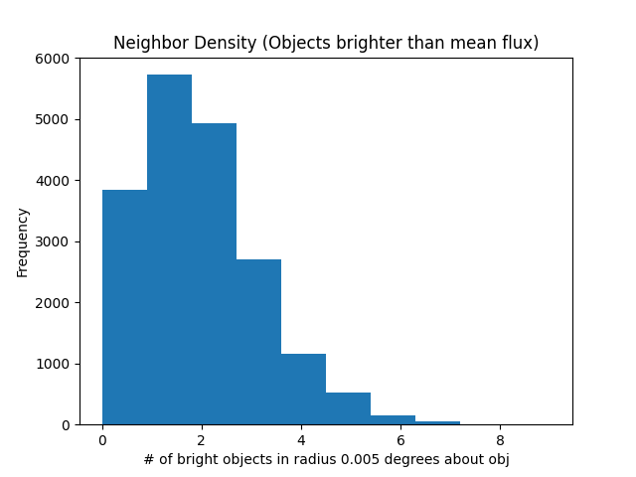
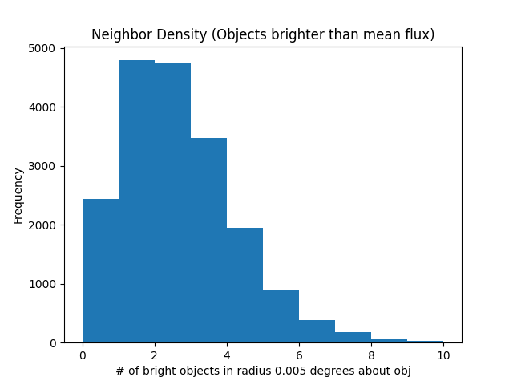
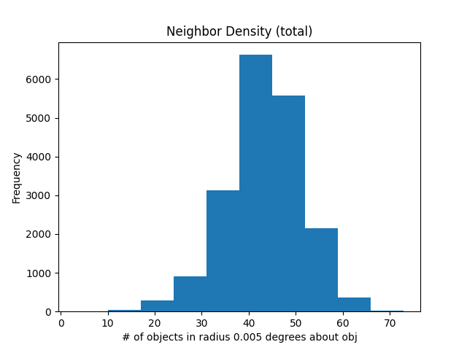
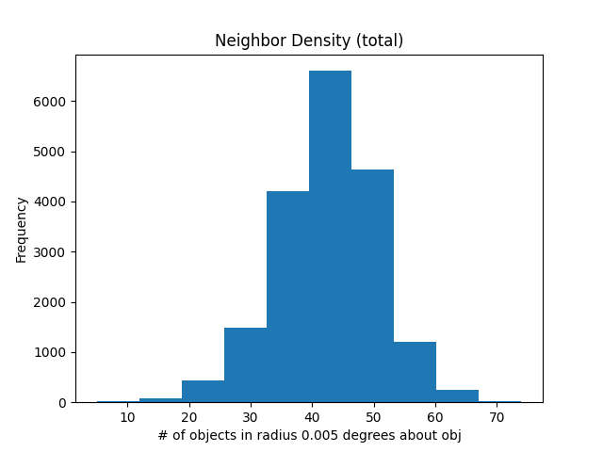
Cosmosk, over common window
HSC g
HSC r

Slide 17
Results
For total density, on average
a1689
BIT
Band 1 = 15 obj/arcmin^2
Band 2 = 10 obj/arcmin^2
HSC
g Band = 15 obj/arcmin^2
r Band = 17 obj/arcmin^2
Cosmosk
BIT
Band 1 = 14 obj/arcmin^2
Band 2 = 10 obj/arcmin^2
HSC
g Band = 45 obj/arcmin^2
r Band= 42 obj/arcmin^2
(Still) blended objects in the HSC combinations for cosmosk, maybe it doesn’t throw off the fit as much with 1xg as opposed to 2xr? ~90% vs. ~50%

